Slide 1

Capstone Project -1
(Exploratory Data Analysis)
Hotel Booking Analysis
Ajit Kumar Patel

Slide 2
Content
Introduction to EDA
Data summary
Define problem statement
EDA of Data set
Obesrvation and suggestions

Slide 3

Introduction to EDA
WHAT?
Exploratory Data Analysis is a process of examining or understanding the data and extracting insights or main characteristics of the data. EDA is generally classified into two methods, i.e.
1) graphical analysis and
2)non-graphical analysis.
EDA builds a robust understanding of the data, and issues associated with either the info or process. (it's a scientific approach to get the story of the data)

Slide 4


Introduction to EDA
WHY?
Technically, The primary motive of EDA is to
Examine the data distribution
Handling missing values of the dataset(a most common issue with every dataset)
Handling the outliers
Removing duplicate data
Encoding the categorical variables
Normalizing and Scaling

Slide 5

Problem Statement
Which accommodation is most preferable by people and what is the cancelation rate?
In which month the reservation is the peak or lowest, and what is the busiest months for hotel and resorts?
What is the Average daily checking by month wise?
How many guests visited the hotel more than once?
What is the previous reservation status of hotels per year?
What is the monthly reservation by market segment?
What are the Adult’s favorite and least favorite meals?
which are the most reserved room types?
From which country the most guests are coming (top 10)

Slide 6
Data Summary
Hotels: Data for two hotels is available Resort Hotel and City Hotel
Lead time: Number of days booking is done before arrival date
Arrival date: Three columns with arrival month, arrival date, and arrival year
Stay days: Two columns with weekend and weekdays
People: Three columns with the number of children, babies, and adults
Market segment: Type of customers grouped together
Repeated guest: Whether customers are repeated or new customer

Slide 7
Data Summary
previous cancellation: Has customer booked the hotel previously and canceled the booking.
Room type: Two columns about which type of room was books and which type of room was
assigned Deposit type: whether customers were asked to give any deposit and which type of deposit it was refundable or non-refundable
Avg Daily rate : what is average daily cost for staying in hotel
Meal-type: which meals were ordered with hotel room
Some other parameters such as Car parking space,status date, special request are also available

Slide 8
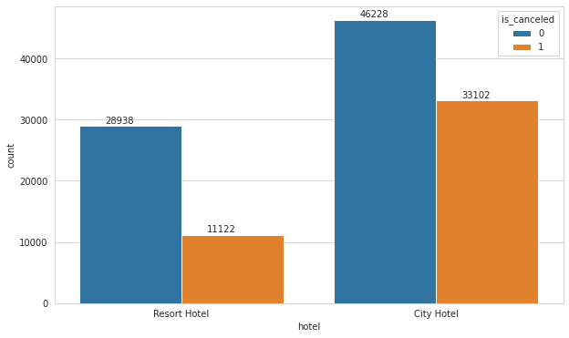
HOTEL: Q) Which accommodation is most preferable by people and what is the cancelation rate ?
 | Canceled | Not Canceled
City Hotel | 0.58 | 0.41
Resort Hotel | 0.28 | 0.72
Observation: Out of all bookings 66.4 % bookings are for a city hotel and the cancelation rate is also high and 33.6 % of bookings are for a resort hotels and the cancelation rate is low as compared to city hotel

Slide 9
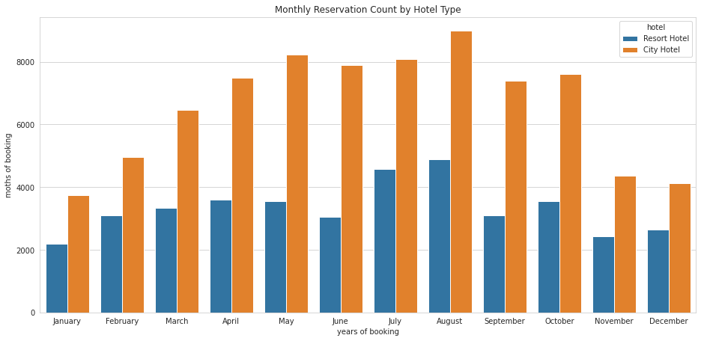
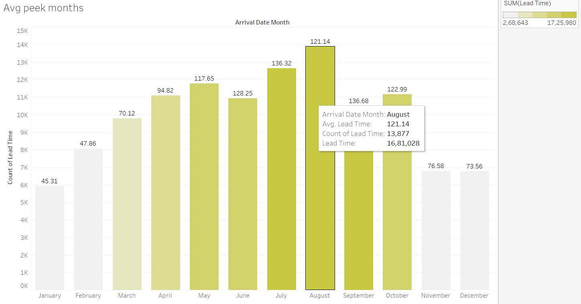
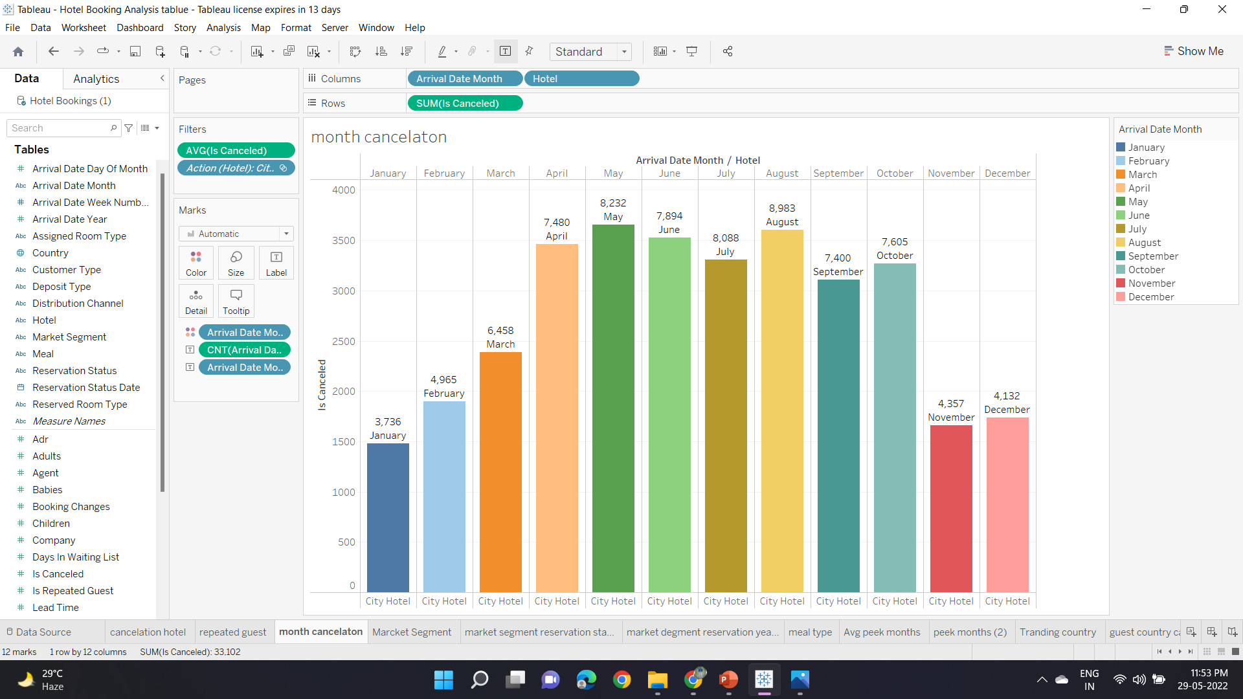
Lead Time and Cancelation: (B)In which month the reservation is in peack,lowest and what is the busiest months for hotel and resorts?
In the case of a city hotel, months with high bookings (May, June, September, October) also witnessed more cancellations. Guest numbers for the Resort hotel go down slightly from June to September through variations in bookings and cancellations are less in the case of a resort hotel. Both hotels have the fewest guests during the winter.

Slide 10
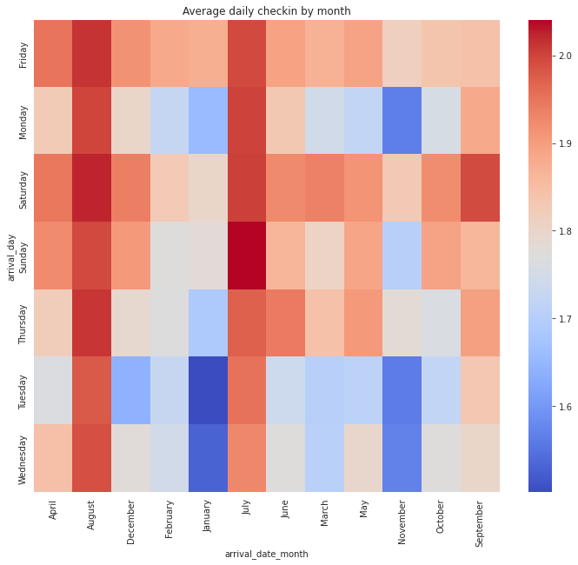
Check in day C) What is the Average daily checking by month wise ?
Most of the check-in is on the weekend Friday and Saturday counts have the highest booking.
Monday, Wednesday and Tuesday have the lowest booking.

Slide 11
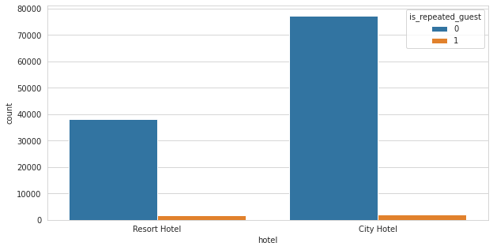
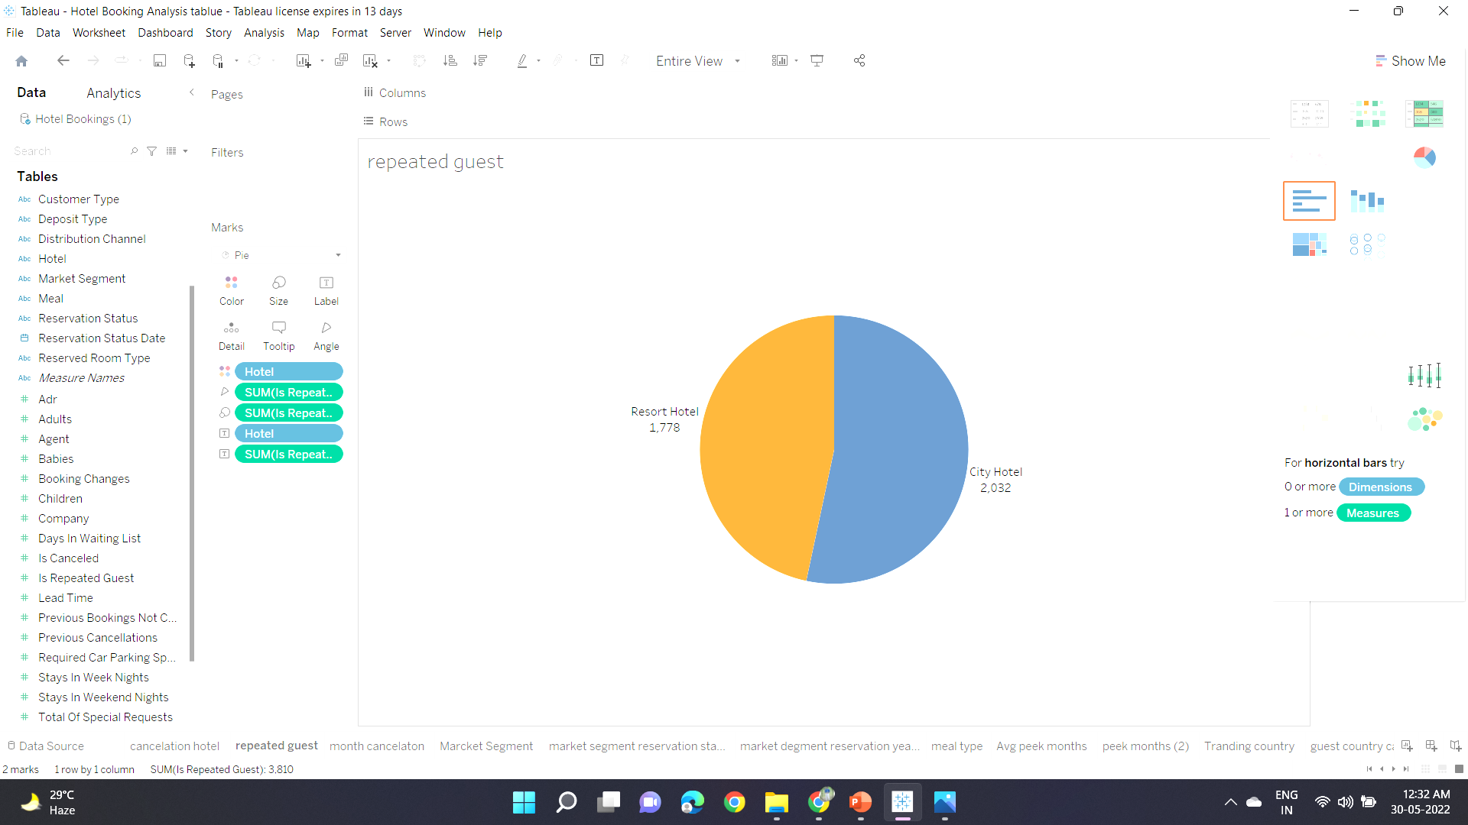
Repeated Guest: D) How many guests visited hotel more than once?
Both hotels have a very small number of booking from old customers.
In City Hotel 2032 (2.56%) and in Resort Hotel 1778 (4.43%)guests visited more than once which shows the overall service of the hotels was good.

Slide 12
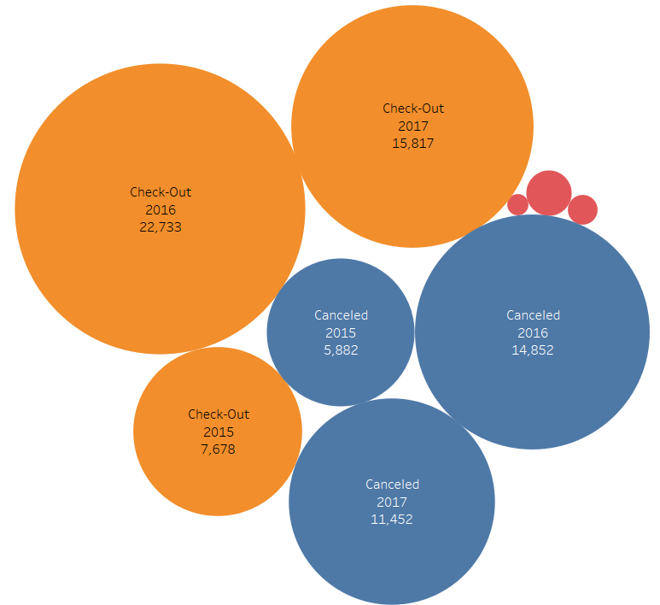
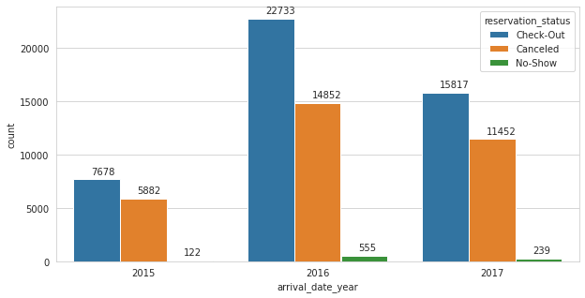
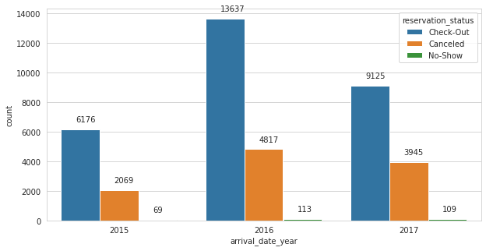
Reservation status: E) What is the previous reservation_status of hotels per year ?
in 2016 the city hotel's 75% of booking are canceled. and in 2017 more than 60% of bookings are canceled.
booking and cancellation are high in counts

Slide 13
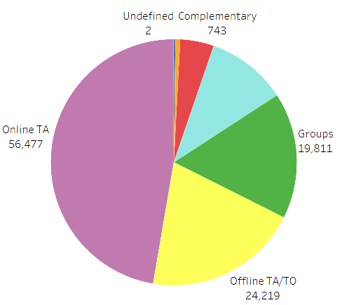
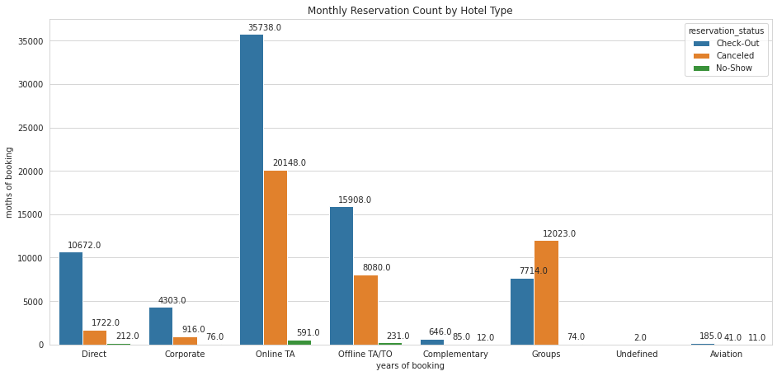
Market Segment: F) What is the monthly reservation by market segment ?
Online TA, Groups make the most cancellation of hotels as compared to other market segment category.
Indirect bookings through online and offline travel agents are higher compared to direct bookings and the same is the case with group bookings which are also high.

Slide 14
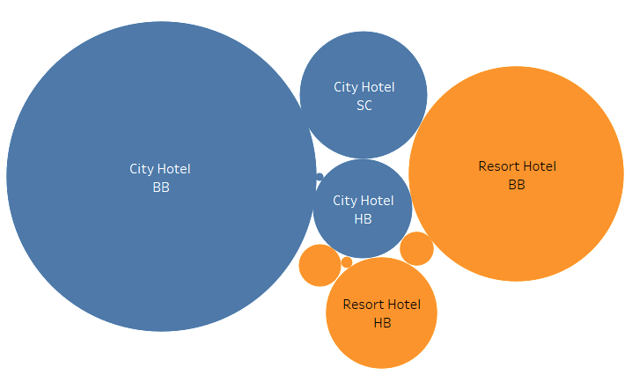
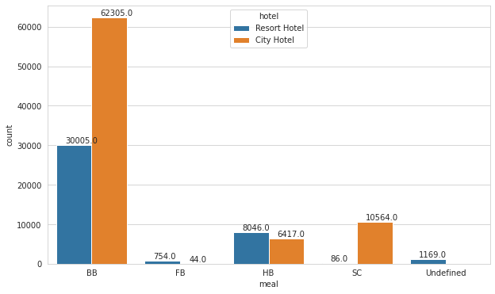
Meals type: g) What are the Adults favorite and least favorite meal?
The categories in the meal column mean:
BB: Bed & Breakfast
HB:: Half board (breakfast and one other * meal – usually dinner)
FB: Full board (breakfast, lunch and dinner)
Undefined/SC: no meal package
Bed & Breakfast is the most common option among the customers in every hotel type.

Slide 15
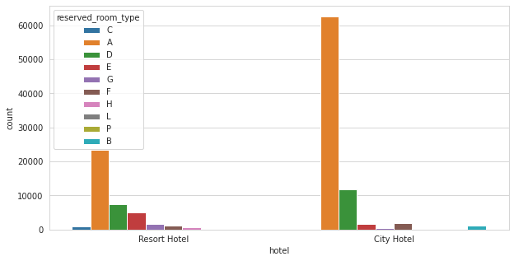
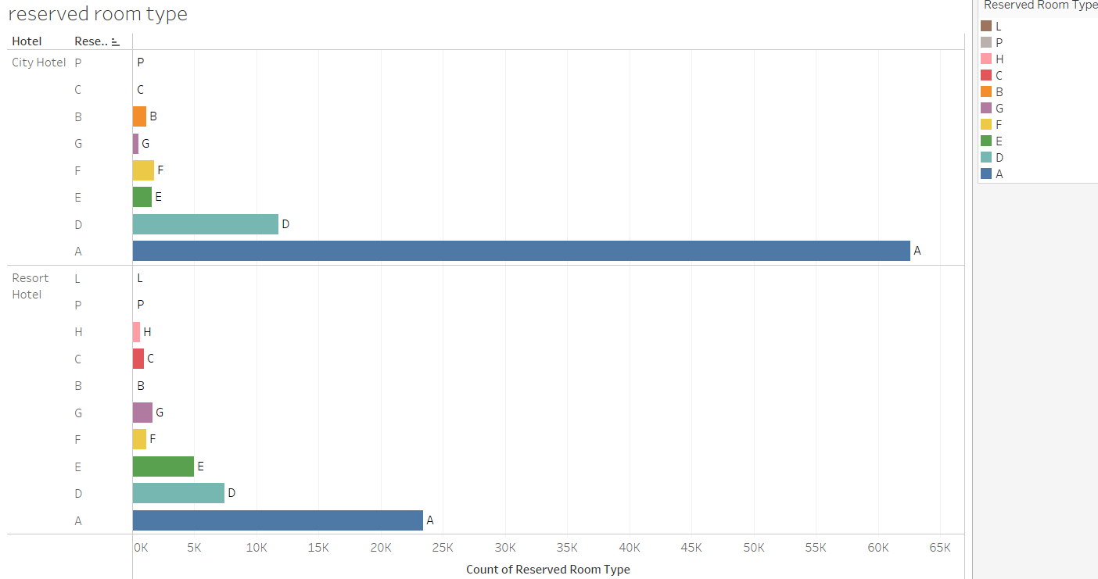
Room type: H) which are the mostly reserved room types are ?

Slide 16
Room Type:
 | ALL | CITY HOTEL | RESORT HOTEL
LOW COST | 87123 | 63270 (73.137%) | 23403 (26.86%)
ECONOMIC | 25742 | 13321 (51.74%) | 12421 (48.25%)
PREMIUM | 3829 | 1805 (47.14%) | 2024 (52.85%)
LUXURY | 2695 | 484 (17.95%) | 2211 (82.04%)
The “low cost" type room is most liked by people and then “economics" type in both hotel.
Most high-value customers choose the resort hotel while low-value customers choose the city hotel.

Slide 17
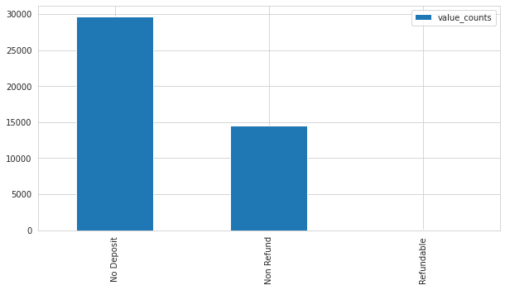
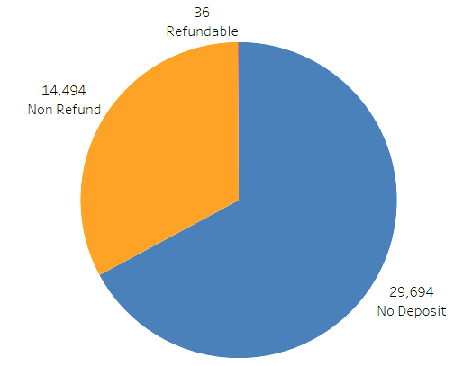
Deposit type: I) Which deposit type has more chance to cancel the booking?
No Deposite customer type are more likely to cancel the booking more than the other types
Non Refundable are less chaces as compare to No deposite type customer.

Slide 18
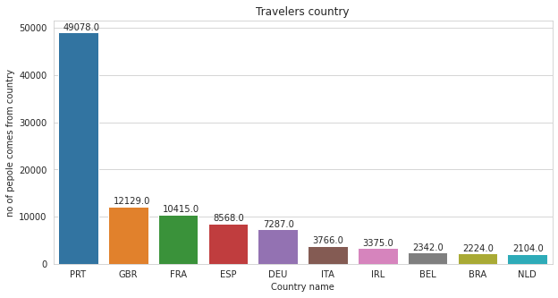
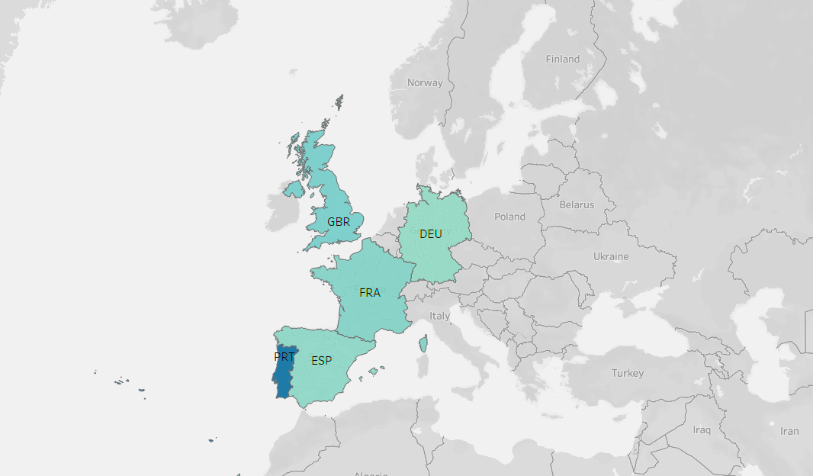
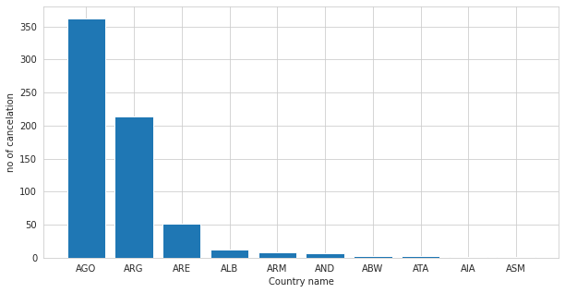
Country: J) From which country the most guests are coming (top 10)
Most of the foreigner are coming from partugal(prt).
AGO (angola) ,ARG(Argentina) makes the most cancelation hotels.

Slide 19
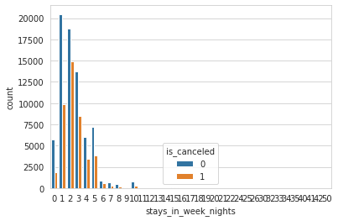
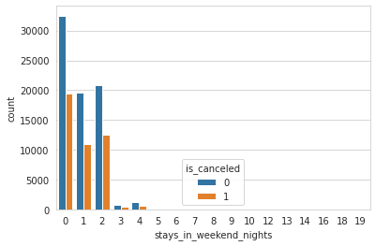
Week night & weekend night:
Maximum number of stays in week nights in each hotel?
Maximum number of stays in weekend nights in each hotel?
Avg cancelation for both weekday and weekend booking is almost same

Slide 20
Previous Cancellations:
Repeated customer with no previous cancellation have very less percentage of booking cancellation
People who have canceled once have more cancellation
People above 6 cancellation mostly cancel the bookings
Cancel group | % customers of total repeat customers | % canceled of the cancel cat people
0 | 75.66 | 3.1
1 | 18.18 | 59.7
2 | 1.99 | 21.05
[3-6] | 2.88 | 20

Slide 21
Recommendation:
Hotels should charge some booking deposit for the following types of people:-
People who have a lead time greater than 100 days
Customers with the previous cancellation
Large group bookings
Resources management
Weekends are busiest
Most people order breakfast
Nov, Dec ,Jan, Feb , and March are the least busy months

